Slide 1
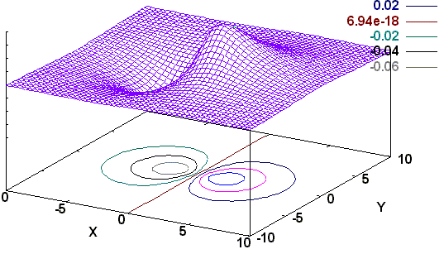
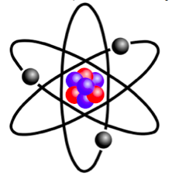
Lecture 11:Atomic orbitals and Orbital Approximation

Slide 2
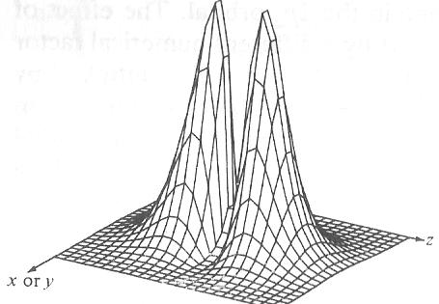
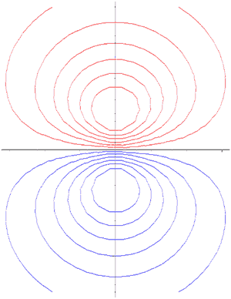
Recap!
Radial Distribution Functions (r²R²) for different Quantum states or orbitals!
Angular Functions (Polar Plots!)
Merging the ( Radial x Angular) parts = shapes of orbitals
Arriving at Contours of constant probability!
Contour representation of Orbitals.

Slide 3
Why did we talk about all these complex orbitals when there is only one electron in H-atom?
Excited Electronic States!
Basis for all kinds of spectroscopy!
Multi electron systems: Orbitals
are not that different!

Slide 4
r₁₂= r₁- r₂
Many Electron Atoms
-
Helium is the simplest many electron atom
-
r₂
r₁

Slide 5
r₁₂= r₁- r₂
Many Electron Atoms
-
Helium is the simplest many electron atom
-
r₂
r₁
+
Attraction between nucleus and Electron1
KE of
Electron2
KE of Nucleus
Repulsion between
Electron1 and Electron2
KE of
Electron1
Attraction between nucleus and Electron1

Slide 6
Helium Atom: Separation of nucelar and electronic co-ordinates
ç√
ç√

Slide 7
Helium Atom: The electronic part
The Hamiltonians Ĥ₁ and Ĥ₂ are one electron Hamiltonians similar to that of hydrogen atom

Slide 8
Orbital Approximation
Orbital is a one electron wavefunction
The total electronic wavefunction of n number of electrons can be written as a product of n one electron wavefunctions

Slide 9
Helium Atom: Orbital Approximation

Slide 10
Helium Atom: Orbital Approximation

Slide 11
Helium Atom: Orbital Approximation

Slide 12
Helium Atom: Orbital Approximation

Slide 13
Helium Atom: Orbital Approximation
If we ignore the term
From photoelectron spectroscopy (experiment):
Ignoring is not justified! Need better approximation

Slide 14
Many Electron Atoms
, 1-electron Hamiltonians
Inter-electron repulsion terms:
CANNOT be ignored
Hamiltonian is no longer spherically symmetric and the Time-Independent Schrodinger Equation (TISE) cannot be solved using analytical techniques
Numerical methods must be used solve the TISE

Slide 15
Many Electron Atoms: Orbital Approximation
Improvement
: Interaction between the electrons.
Electron and nucleus: opposite charges
Electron and electron: Same charge
Net nuclear attraction perceived by an electron
= Actual Nuclear attraction – repulsion by other electrons
⇒ Shielding
Notes:
Which mean the electron move in the
potential provided by the nucleus and rest of the electron.
Since the electron and nucleus have opposite charges, it can
be thought that the rest of the electrons reduce the charge felt
by a particular electron
⇒Shielding

Slide 16
Effective Nuclear Charge
For Helium atom

Slide 17
Effective Nuclear Charge
Due to Shielding, the electrons do not see the full nuclear charge Z, but Z_{eff} = Z–σ (σ = Shielding Constant)
For Helium atom
There are methods such as Perturbation Theory and Variational Method to estimate Z_{eff}

Slide 18
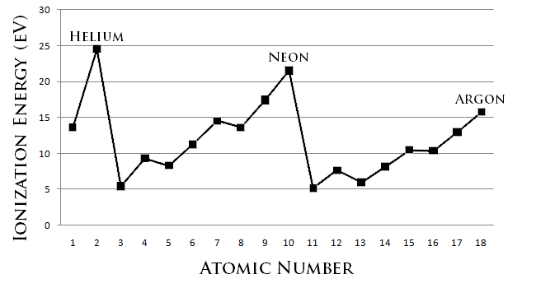
Effective Nuclear Charge
Due to Shielding, the electrons do not see the full nuclear charge Z, but Z_{eff} = Z–σ (σ = Shielding Constant)
Effective nuclear charge is same for electrons in the same orbital, but varies greatly for electrons of different orbitals (s,p,d,f) and n.
Z_{eff} determines chemical properties of many electron atoms

Slide 19
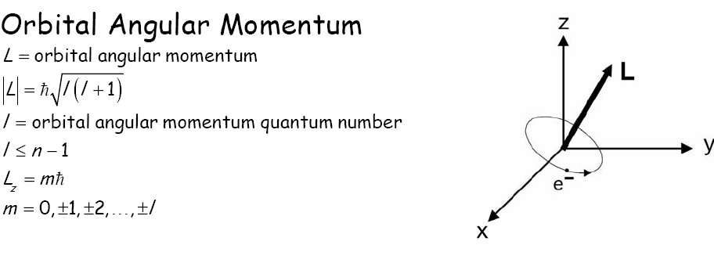
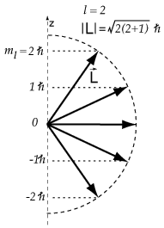
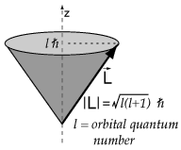
Spatial (Orbital) Angular Momentum of Electrons in the atom
Notes:
19

Slide 20
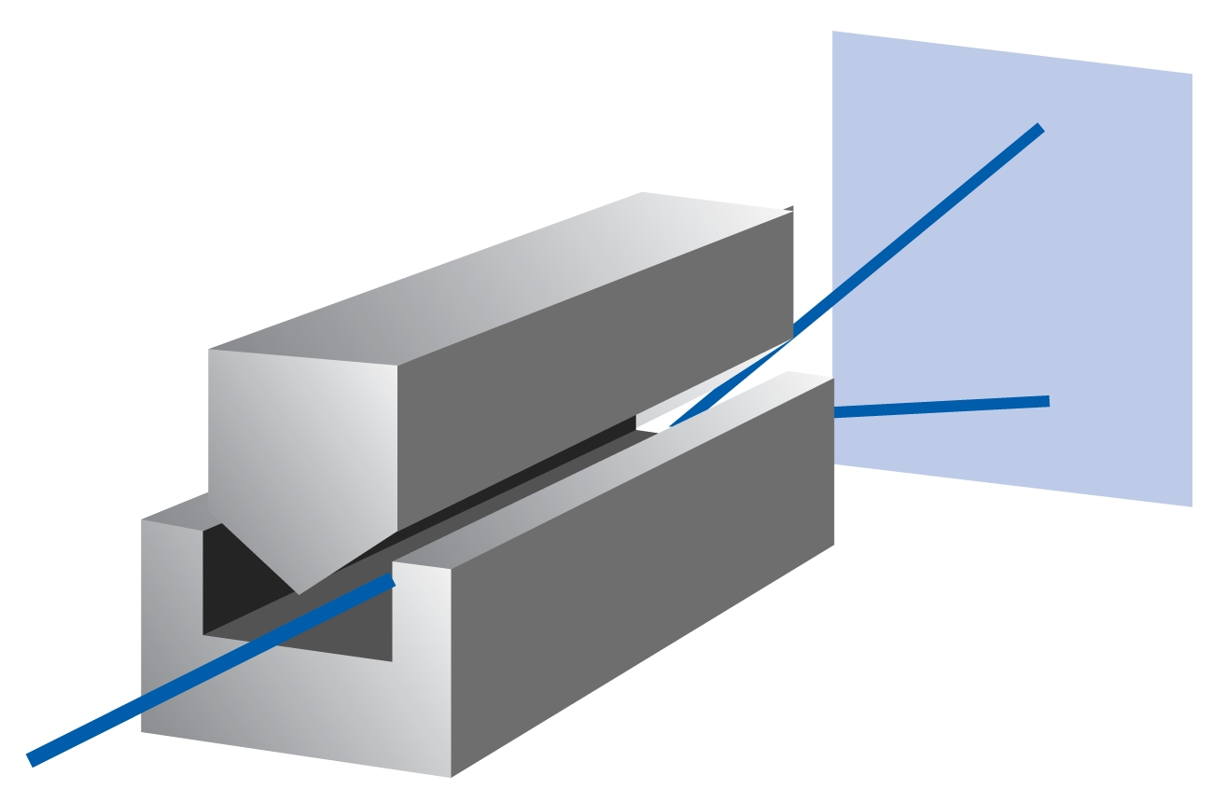
“Spin” of an electron: Late comer to the quantum party
Stern-Gerlach Experiment (1922):
Beam of Ag atoms (4d¹⁰ 5s¹) passed through an inhomogeneous magnetic field: TWO lines
Uhlenbeck and Goudsmit (1925): Two angular momentum states, Intrinsic to the electron
NOT a result of actual rotation (v >c !!)
Spin: S(ω), ω is an unknown coordinate
Dirac: Relativistic quantum mechanics

Slide 21

If electrons - classical, "spinning" particles - distribution of their spin
angular momentum vectors /magnetic moment in z direction would be random:
deflected up or down by a different amount, producing an even distribution.
But electrons deflected either up or down by a specific (same) amount!!!

Slide 22
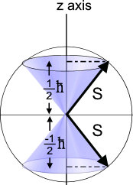
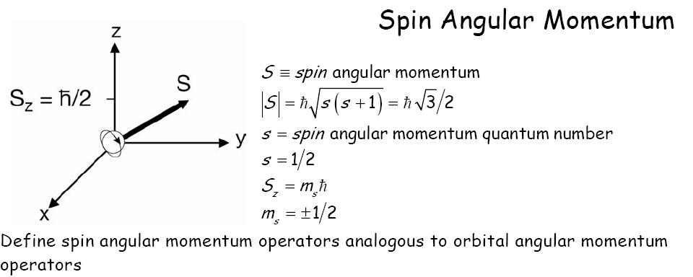
Spin Angular Momentum : Intrinsic and Quantized
Spin Angular Momentum “S’’
For electrons, s = 1⁄2
“spin-up” (or α) and “spin-down” (or β) two eigenfunctions (spin functions) of the operator, same eigen values but opp sign (S-G observables)
NOT a result of actual rotation (v >c !!)

Slide 23
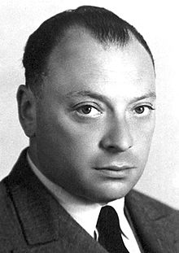
Spin
Completely quantum mechanical property
No classical analogy
Intrinsic (like charge or mass)
Pauli (1924) : “ electron has two-valuedness not describable classically ”

Slide 24
Hydrogen Atom Wavefunctions: Redefined
Incorporate “spin” component to each of the 1-electron wavefunctions: SPIN ORBITALS
Total wavefunctions = product of spatial and spin parts
Each atomic orbital now becomes doubly degenerate
Spin orbitals are orthogonal and normalized. Quantum numbers are n,l,m,m_{s}
SPIN ORBITAL: One electron wavefunction containing spatial as well as spin parts

